Slide 1

Real World Evidence to Profile Hospitals’ Quality of Surgical Cancer Care
Jessica Lavery
Research Biostatistician
Memorial Sloan Kettering Cancer Center

Slide 2

Provider profiles

Slide 3

Profiling surgical cancer care

Slide 4
Potential data sources for profiling surgical cancer care
SEER-Medicare
Medicare
National pool of providers
Cancer stage
National pool of patients
Cancer diagnosis
SEER: Surveillance, Epidemiology and End Results cancer registry

Slide 5

Question #1: Can we identify cancer-directed surgeries from Medicare claims?

Slide 6
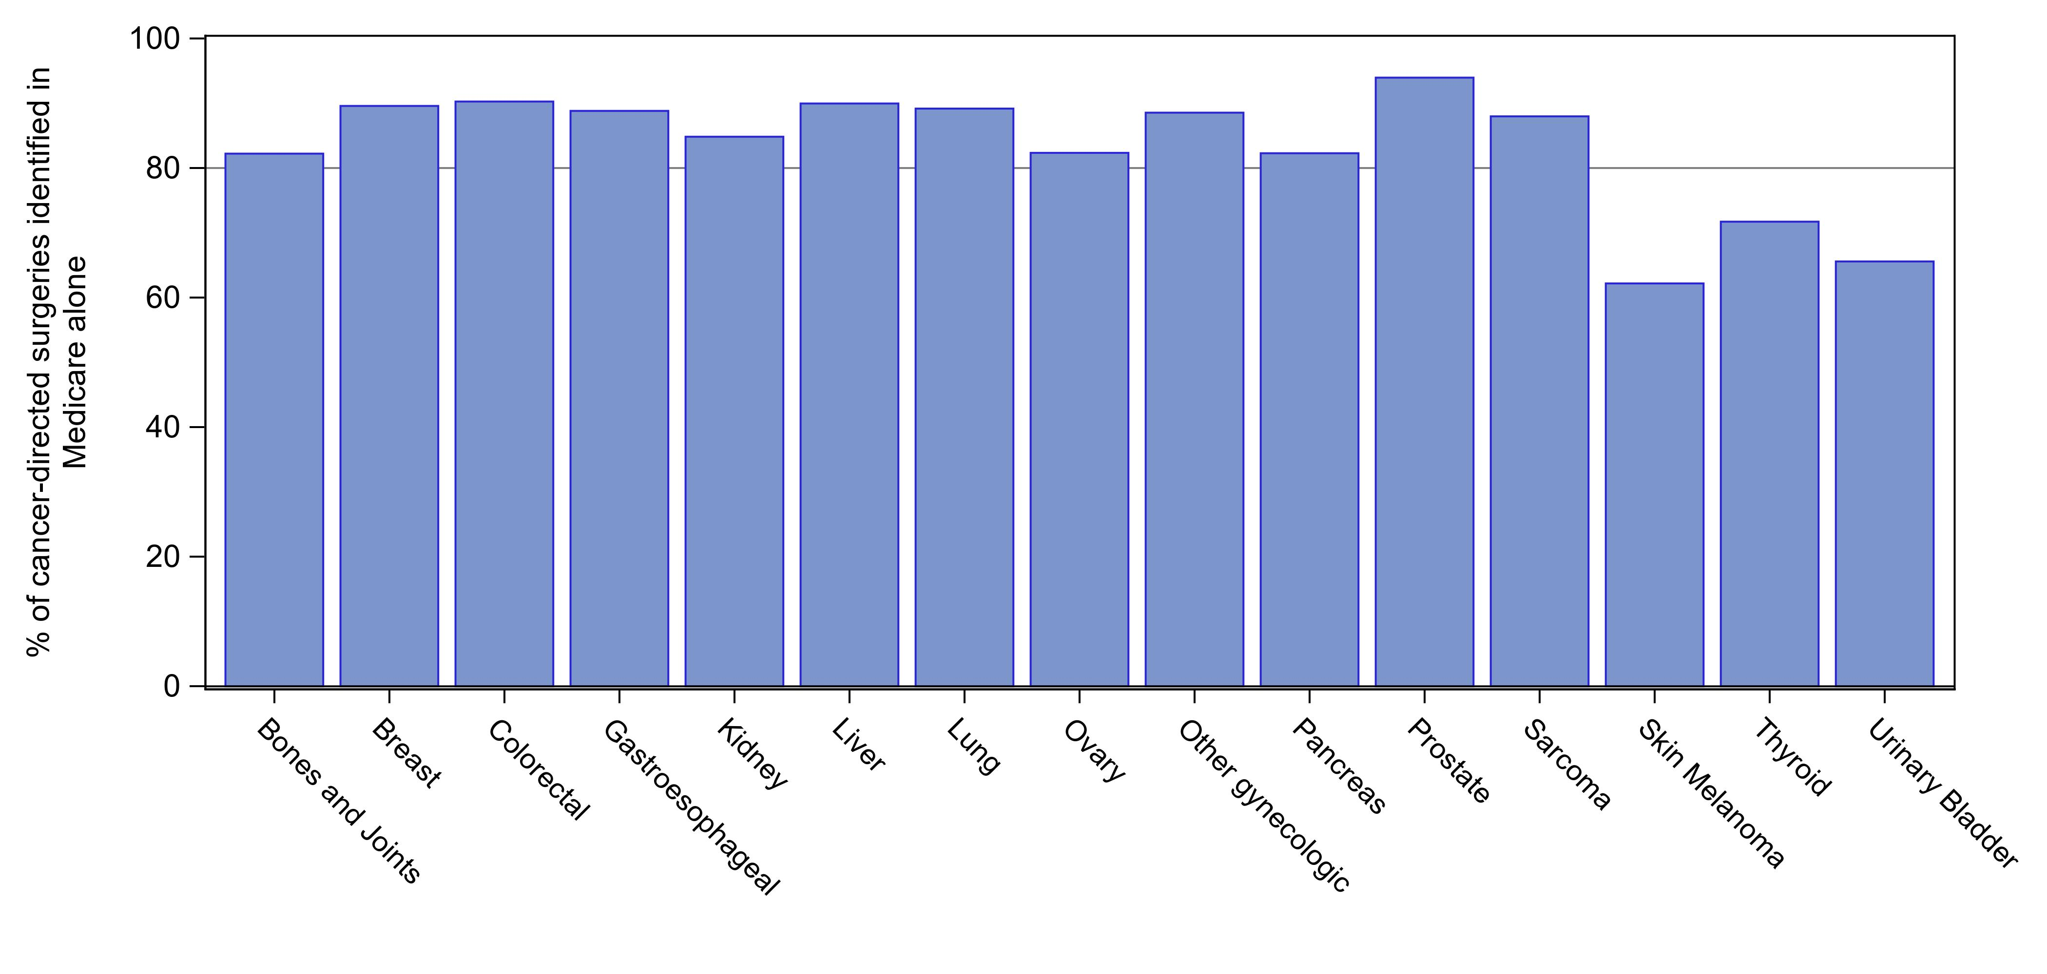
Can we identify cancer-directed surgeries from Medicare claims?
Notes:
Lavery JA, Lipitz-Snyderman A, Li DG, Bach PB, Panageas KS. Identifying Cancer-Directed Surgeries in Medicare Claims: A Validation Study Using SEER-Medicare Data. JCO Clin Cancer Inform. 2019 Feb;3:1-24. doi: 10.1200/CCI.18.00093. PubMed PMID: 30715928.

Slide 7

Question #2: Can we accurately assess hospital performance without information on cancer stage?

Slide 8
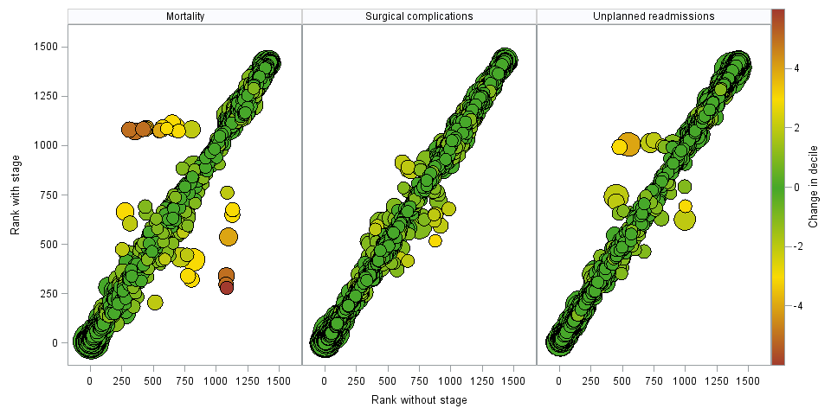
Does hospital rank change after adjusting for cancer stage?

Slide 9

Hospital ranking does not drastically change in the absence of adjustment for cancer stage.
Cancer-directed surgeries can be identified in Medicare claims.
Medicare claims are a feasible data source for identifying cancer-directed surgeries and assessing provider performance for most cancer sites.

Slide 10

THANK YOU!
Jessica Lavery, Research Biostatistician
Memorial Sloan Kettering Cancer Center
@laveressica
laveryj@mskcc.org

Slide 11
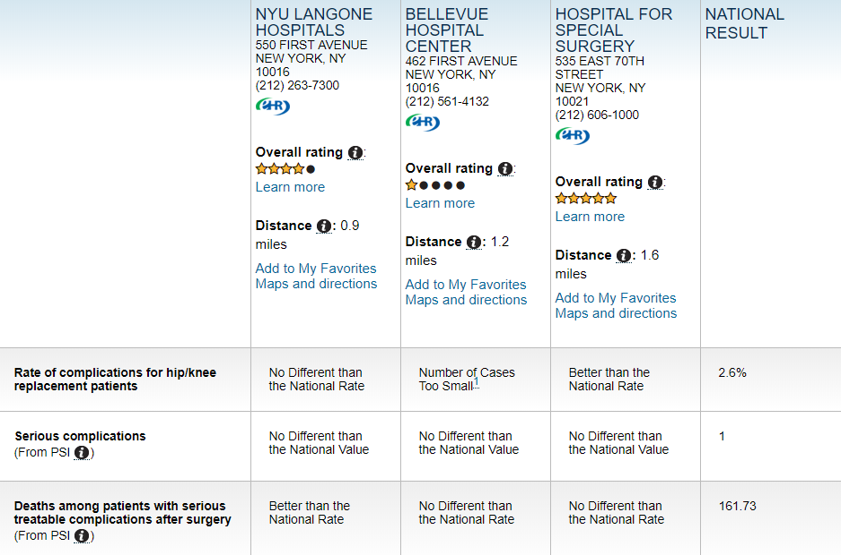

Slide 12

